Slide 1
Data

Slide 2
What’s your take?

Slide 3

*DATA
Notes:
Structed data storage with ease of access to data which helps in making decisions to improve the business

Slide 4
Evolution of data
Handwritten
Punch cards and Magnetic tapes
Relational Databases
Data Warehouses
Big Data
Data Lakes / Data Lakehouse
Data Mesh

Slide 5
OLTP
What worked:
High Performance
Direct Access to Data
What didn’t:
Non-Integrated
Access to RIGHT data
Notes:
With high-performance and direct data access, Online Transaction Systems (OLTP) became possible.
Now there could be online reservation systems, banking teller systems, ATM systems, and the like.
Very quickly, applications grew like weeds in the springtime. Soon there were applications everywhere.
The end user switched from not being able to find data to not being able to find the right data. This sounds like an almost trivial shift, but it was anything but trivial.
To make a decision, the end user had to find which version of the data was the right one to use among the many available applications.

Slide 6
Data Warehousing
What worked:
Integrated Data
Historical Data & Pattern Analysis
What didn’t:
Increased Volume
Can’t handle variety of data
Notes:
The data warehouse led to disparate application data being copied into a separate physical location. Thus, the data warehouse became an architectural solution to an architectural problem.
Stated differently, as important as the data warehouse was, the end user found little value in the data warehouse without the surrounding analytical infrastructure.
Metadata, Data model, Data lineage, Summarization, KPIs & ETL
The past became a great predictor of the future.
The limitations of data warehouses became evident with the increasing variety of data (text, IoT, images, audio, videos, drones, etc.) in the enterprise.
In addition, the rise of Machine Learning (ML) and Artificial Intelligence (AI) introduced iterative algorithms that required direct data access to data not based on SQL.

Slide 7
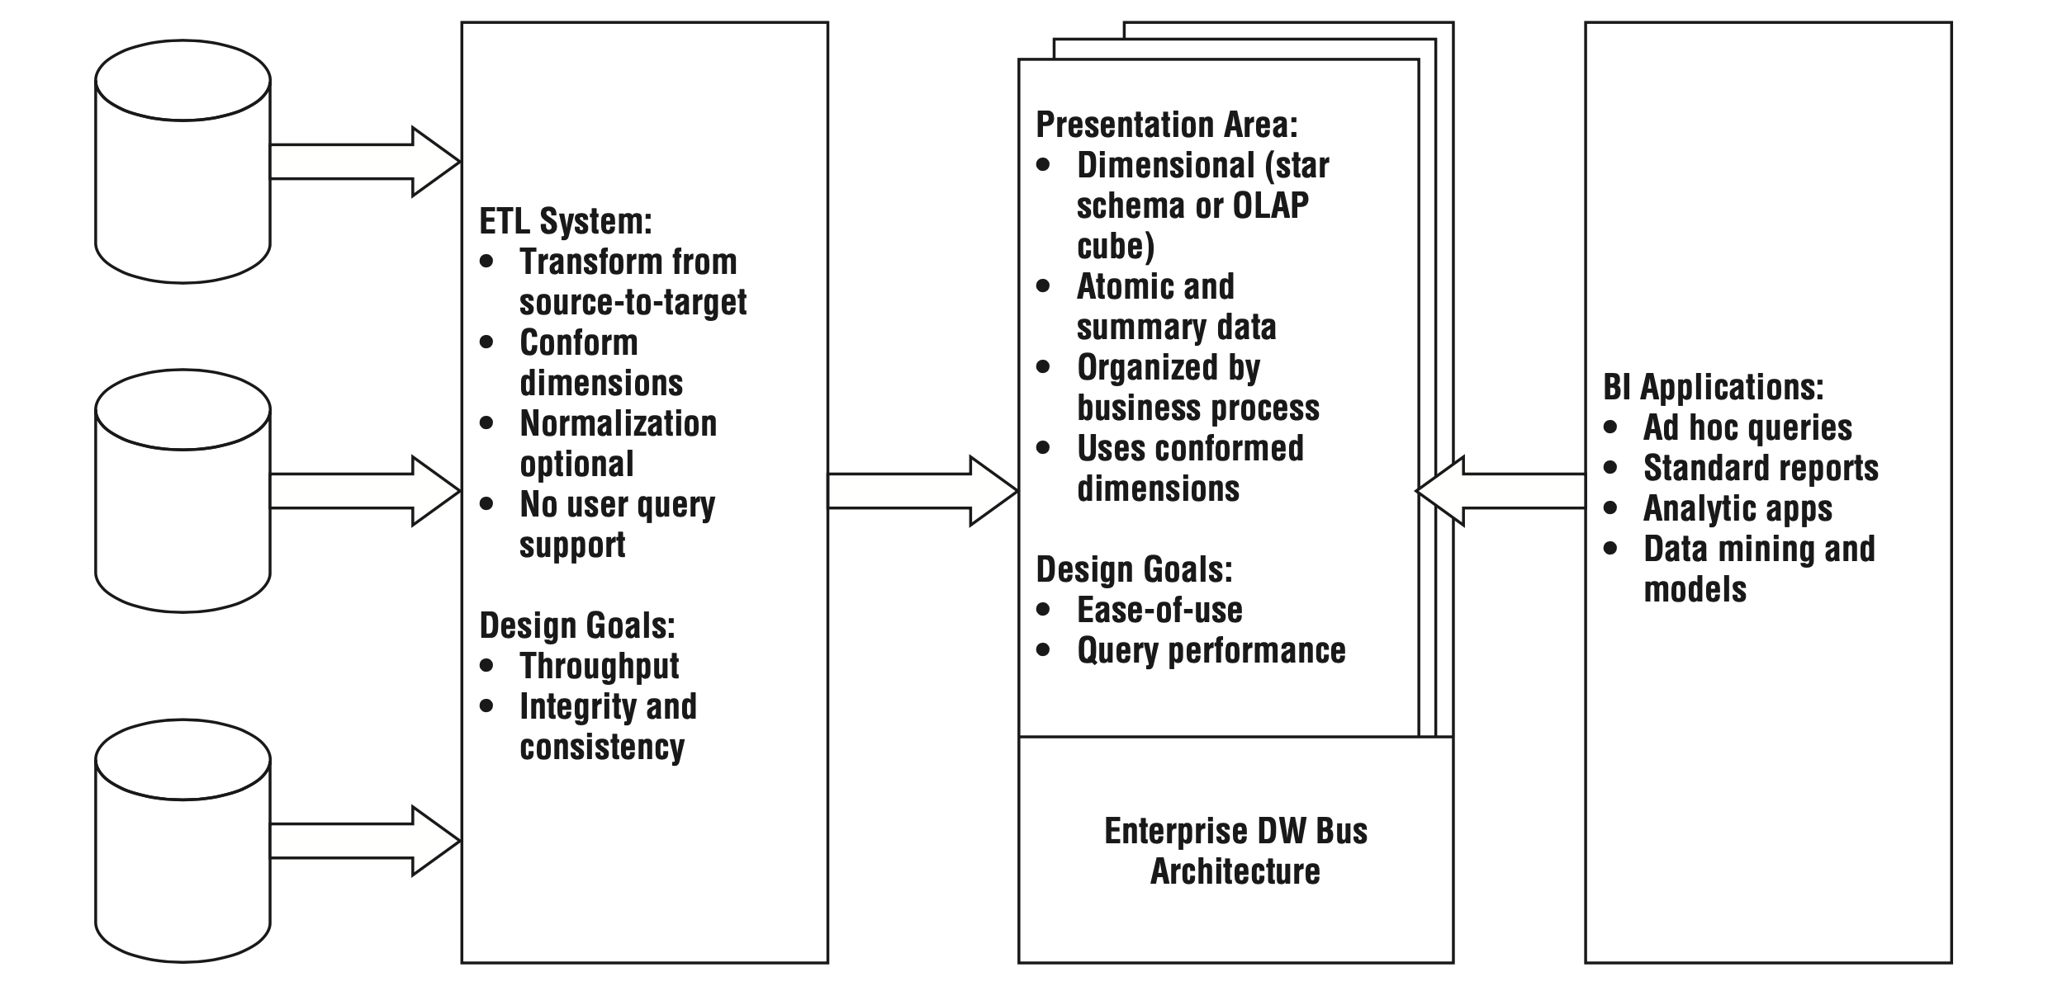
Credits : The Datawarehouse Toolkit, 3rd Edition

Slide 8
Datawarehousing
Data Source
ETL / ELT
Data Modelling
Business Intelligence

Slide 9
ETL
Extract
Transform
Load
Notes:
Data Integration
Data Quality
Automation of processing of data
Regulatory Compliance

Slide 10
Business Intelligence
Visual Representation (A Picture is worth thousand words)
Actionable Insights
Informed Decision making
Notes:
PowerBI, Tableau, Cognos, Thoughtspot & QlikView

Slide 11
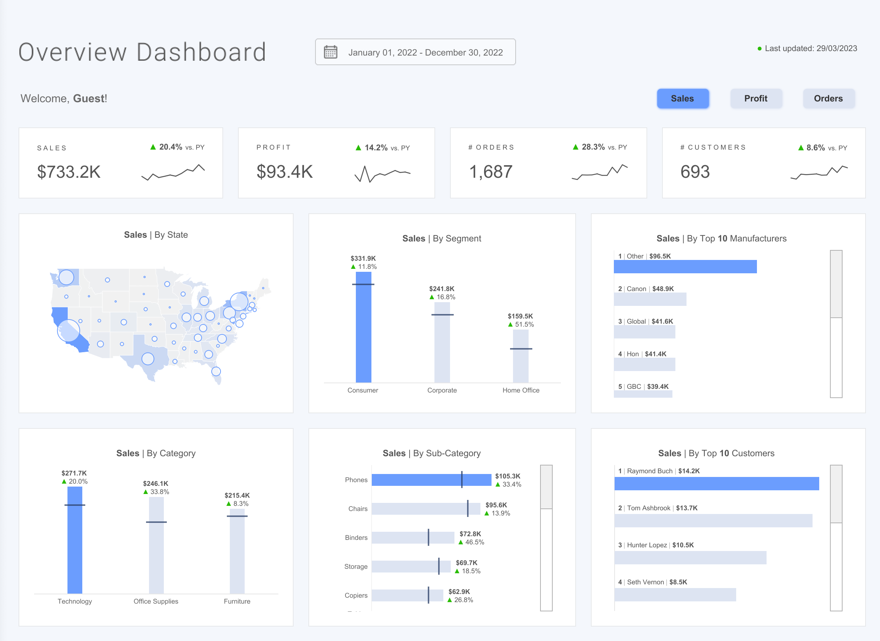

Slide 12
Big data
Volume
Velocity
Variety
Notes:
Framework to store, Handle & Process the different types of data in distributed environment

Slide 13
Data Science
Machine Learning
Deep Learning
Natural Language Processing
Reinforcement Learning (AlphaGo)
AI/AGI
Notes:
https://www.youtube.com/watch?v=WXuK6gekU1Y&ab_channel=DeepMind
Predictive maintenance
Fraud detection
Chatbots and virtual assistants
Marketing and sales
Supply chain optimization
Predictive analytics

Slide 14
Data Lakes
What worked:
Centralized Repository
Low-cost object storage
What didn’t:
No Management of data
No Data Quality/Governance

Slide 15
Data LakeHOUSE
Built on top of Data Lakes
Bringing Reliability and Quality
Data Governance and Security
Performance optimization (Like Statistics)
Open-Source Format (Apache Parquet and ORC)
Notes:
Metadata, Data Model, Data Quality, ETL/ELT, Textual ETL, Volume of data, Lineage, KPI, Schedules & Summarization
Complexity, Integration, Performance, Governance, Cost,these potential shortcomings can be mitigated through careful planning, design, and managemen

Slide 16
Data MESH
Decentralized approach
Data is treated as a product
Owned by individual domain teams
Increased data quality & accessibility

Slide 17
Big Data | ETL | Business Intelligence | Data Science
Apache Spark | Talend | PowerBI | AWS SageMaker
Hive | Informatica PowerCenter | Tableau | Azure Machine Learning
Pig | IICS | Qlik Sense | Google AutoML
Sqoop | IBM DataStage | ThoughtSpot | IBM Watson Machine Learning
Apache Kafka | Azure Data Factory | IBM Cognos | Dataiku
HBase | Abintio | AWS QuickSight | Databricks Lakehouse
Flume |  |  | Model API's (ChatGPT)

Slide 18
Data Roles
DBA
Data Analyst
Data Engineer
Data Scientist
Machine Learning Engineer
Prompt Engineer

Slide 19
Applications
Notes:
Be it just a plain statistics analytics, or recommendation system or Google to ChatGPT data is everywhere

Slide 20
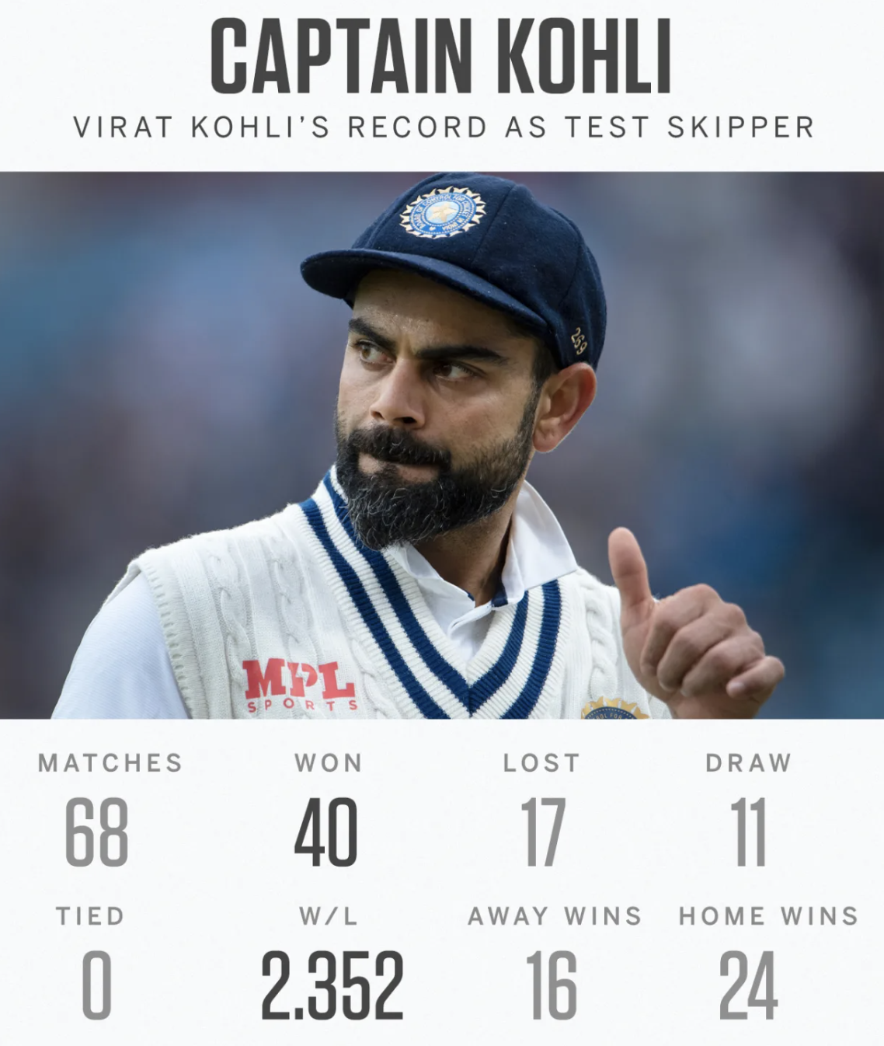

Slide 21
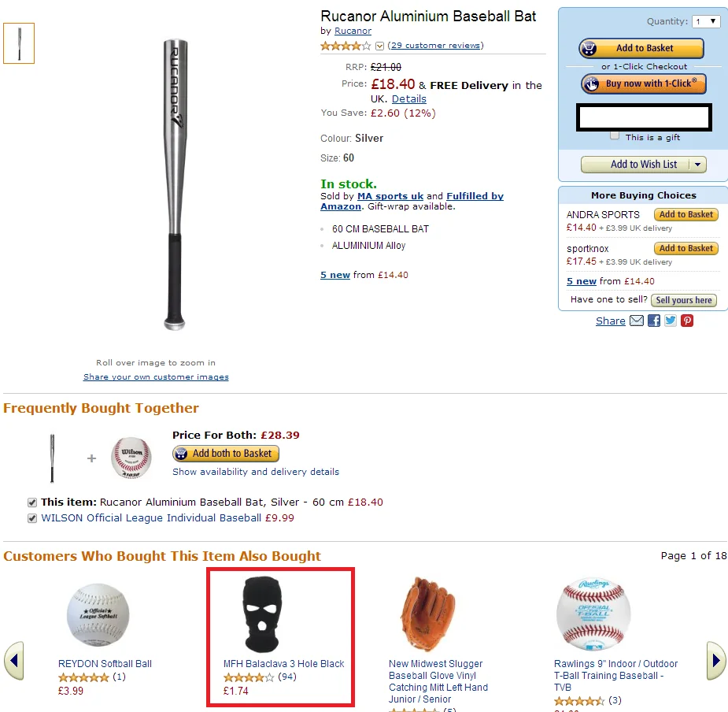

Slide 22
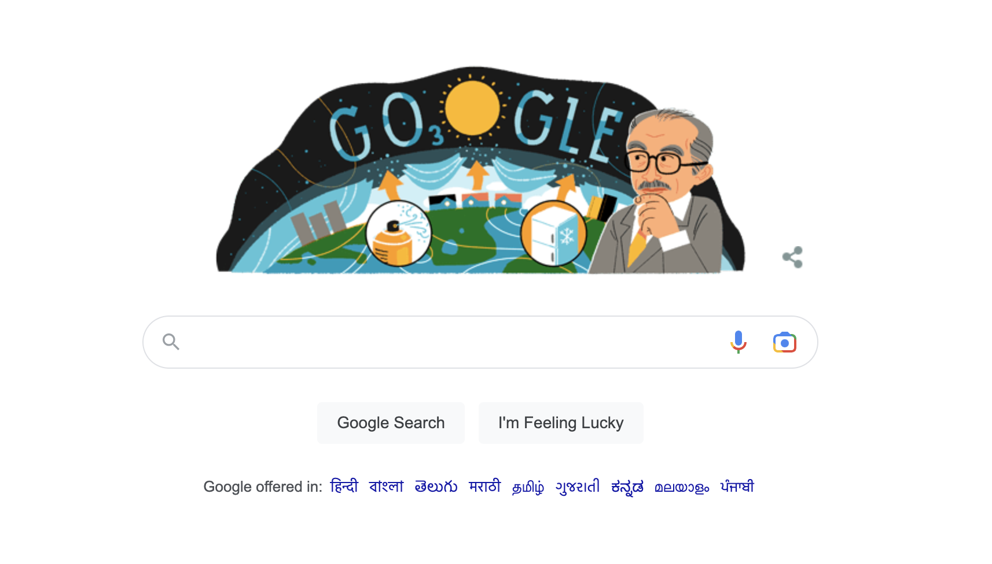

Slide 23
